Slide 1
Poisson response models

Slide 2
Application of Bayesian Inference
As in other application clases, we will focus on:
a) model elicitation (prior and likelihood), b) interpretation of results. (not so much at all in conditional posterior distributions)
We will continue to perform convergence diagnostics.

Slide 3
Outline
Generalized linear models (review)
Poisson models
Basic model
Exposure and Offset
Testing differences (applicable to ANY linear models)
Advanced models:
Overdispersion
Multilevel
Parameter interpretation
Example

Slide 4




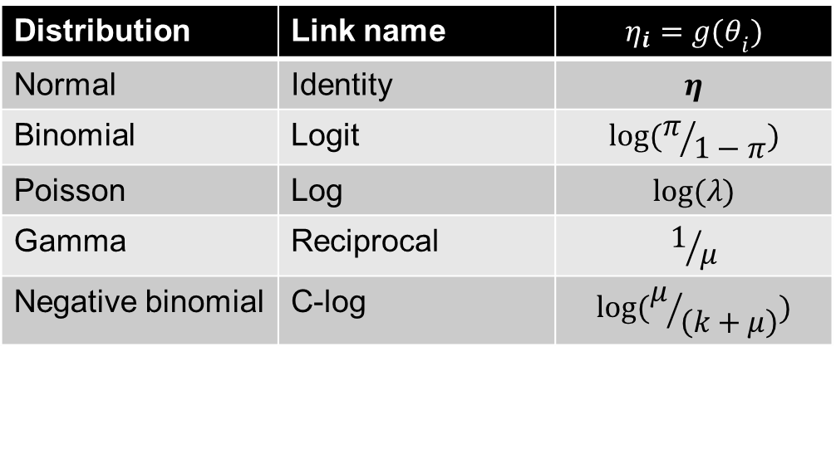
GLM (generalized linear models)
Vector of observations
Linear predictor
Link function connects linear predictor and “transformed data”
A probability density function of observed data
Distribution | Link name
Normal | Identity
Binomial | Logit
Poisson | Log
Gamma | Reciprocal
Negative binomial | C-log

Slide 5



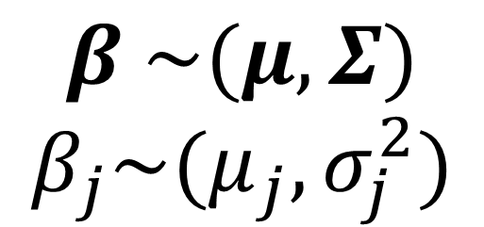
Simple Poisson regression
Link function: log
Priors

Slide 6


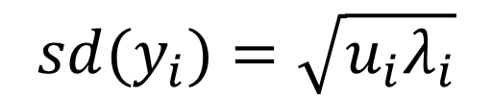
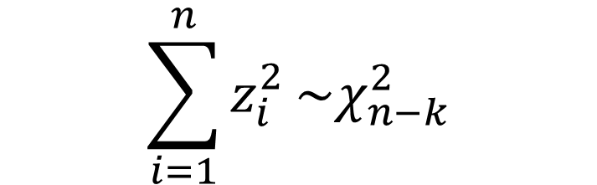
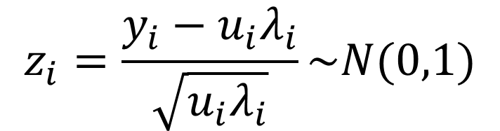
Overdispersion
This statistic can be used for model checking

Slide 7

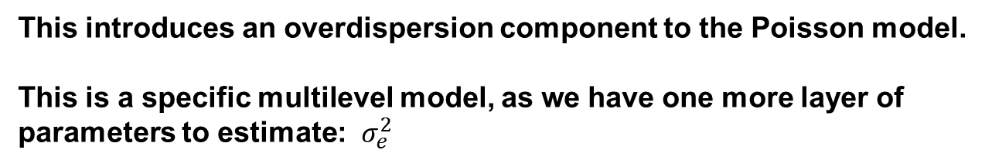


Modeling overdispersion
$$log\left(u_{i}λ_{i}\right)=\log\left(1\right)+x_{i}β+e_{i}$$
$$e_{i}\sim N(0,σ_{e}^{2})$$
$$σ_{e}^{2}\sim I−Gamma(s_{e},r_{e})$$
This introduces an overdispersion component to the Poisson model.
This is a specific multilevel model, as we have one more layer of parameters to estimate: $σ_{e}^{2}$

Slide 8

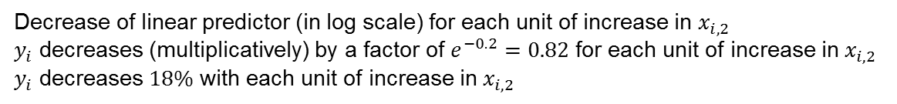
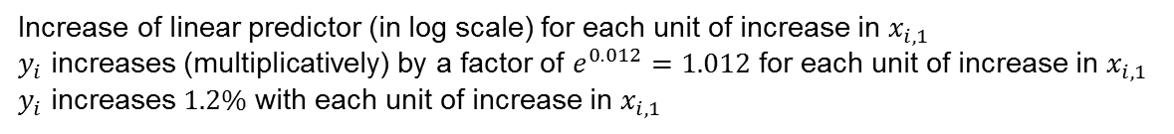
Parameter interpretation
$$y_{i}\sim Poisson(u_{i}λ_{i})$$
$$log\left(u_{i}λ_{i}\right)=log\left(u_{i}\right)+0.012x_{i,1}−0.2x_{i,2}$$
Increase of linear predictor (in log scale) for each unit of increase in $x_{i,1}$
$y_{i}$ increases (multiplicatively) by a factor of $e^{0.012}=1.012$ for each unit of increase in $x_{i,1}$
$y_{i}$ increases $1.2\%$ with each unit of increase in $x_{i,1}$
Decrease of linear predictor (in log scale) for each unit of increase in $x_{i,2}$
$y_{i}$ decreases (multiplicatively) by a factor of $e^{−0.2}=0.82$ for each unit of increase in $x_{i,2}$
$y_{i}$ decreases $18\%$ with each unit of increase in $x_{i,2}$
MCMC inference
$f_{j}=\left({1−e}^{β_{j}}\right)∗100$ Can be computed at each iteration of the MCMC, so that a full posterior distribution of the % change can be estimated if that is a parameter of interest (or easier to interpret)

Slide 9
GLM in Stan
Stan provides many distributions, and it has the particularity of providing combinations of link and distributions
Some distributions used in GLM
Distribution | Stan | Mean | Variance
Normal | y~normal(mu,sigma) | mu | sigma²
Binomial | y~binomial(N,p) | Np | Np(1-p)
Negative Binomial | y~neg_binomial_2 (mu,phi) | mu | mu/phi
Poisson | y~poisson (lambda) | lambda | lambda
Poisson GLM | y%~poisson_log(log_lbd) | lambda | lambda
Notice that many of these distributions accept alternative parameterizations in stan

Slide 10
Modeling Poisson distributions in Stan
Vectors are highlighted in bold.
The linear predictor
#Transformed parameters
log_lbd=alpha+beta1*x1+beta2*x2
#Model:
Y~poisson_log(log_lbd);
alpha~normal(,);
beta1~normal(,);
beta2~normal(,);
#transformed quantities
lambda=exp(log_lbd)
Likelihood and priors
Poisson parameter if needed
Random variate generator:
Log-mass probability function:
poisson_log_rng (alpha)
poisson_log_lpmf(Y|alpha)

Slide 11
Adding random effects in stan: over-dispersed Poisson
Define standardized residuals (parameters) and scaled residuals (transformed parameteers).
#parameters
vector [n] e;
real alpha;
real beta;
#transformed parameters
Vector [n] res;
res=sigma*e;
log_lambda = alpha + beta * x + res;
sigma~cauchy(0,5);
for (i in 1:n)
e[i]~normal(0,1);
Y~poisson_log(log_lambda);
The linear predictor
Scaled residual=random effects
Auxiliary quantities
Standard residual
Likelihood and priors

Slide 12
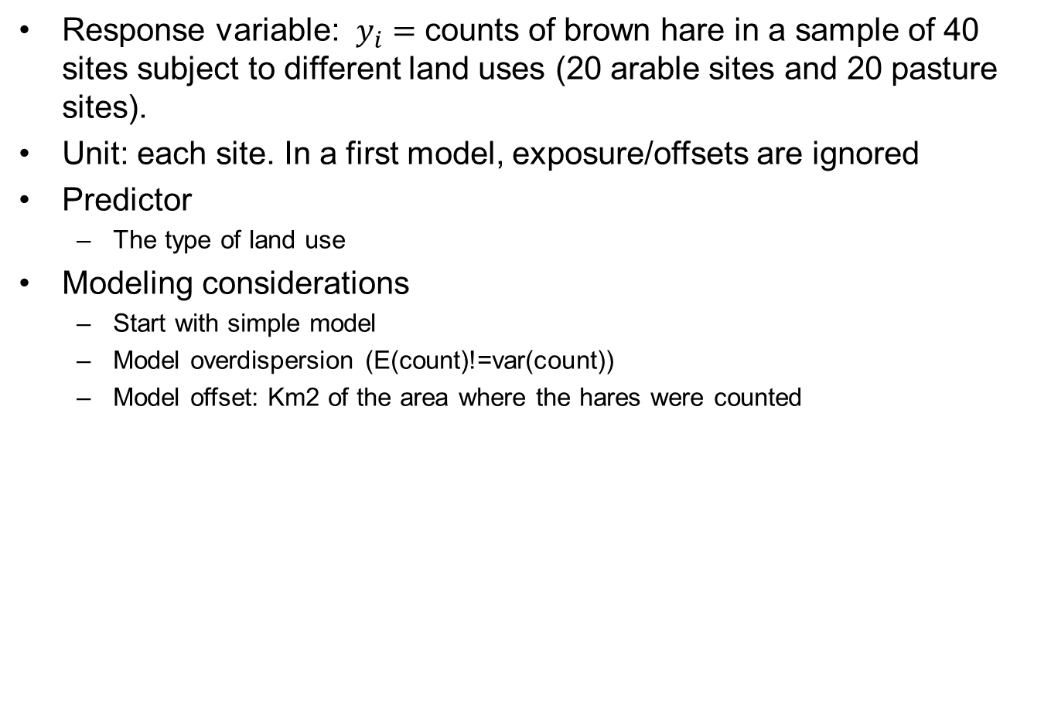
Data
Response variable: $y_{i}=$ counts of brown hare in a sample of 40 sites subject to different land uses (20 arable sites and 20 pasture sites).
Unit: each site. In a first model, exposure/offsets are ignored
Predictor
The type of land use
Modeling considerations
Start with simple model
Model overdispersion (E(count)!=var(count))
Model offset: Km2 of the area where the hares were counted

